Slide 1
QAC 211 PRESENTATION
Toward a better understanding on soccer
Patton Yin

Slide 2
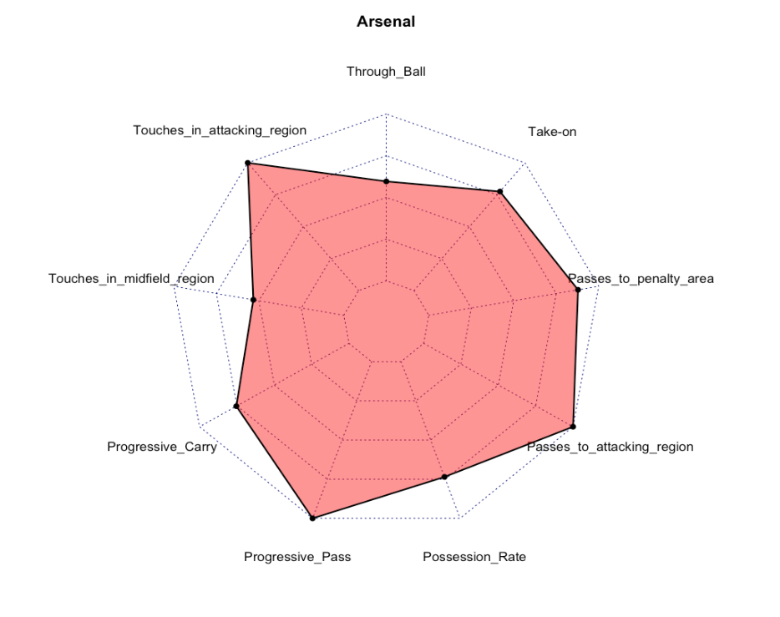
My Understanding on Data & My Plan
Preferences of teams
How these Preferences are carried out & shared by different players of this team
Is it effective?
Trend; Solution; Predict
A comprehensive understanding through –
Team tactics
Individuals share responsibility
Effectiveness of implementation
Attack – elaborate attack
Why data?

Slide 3
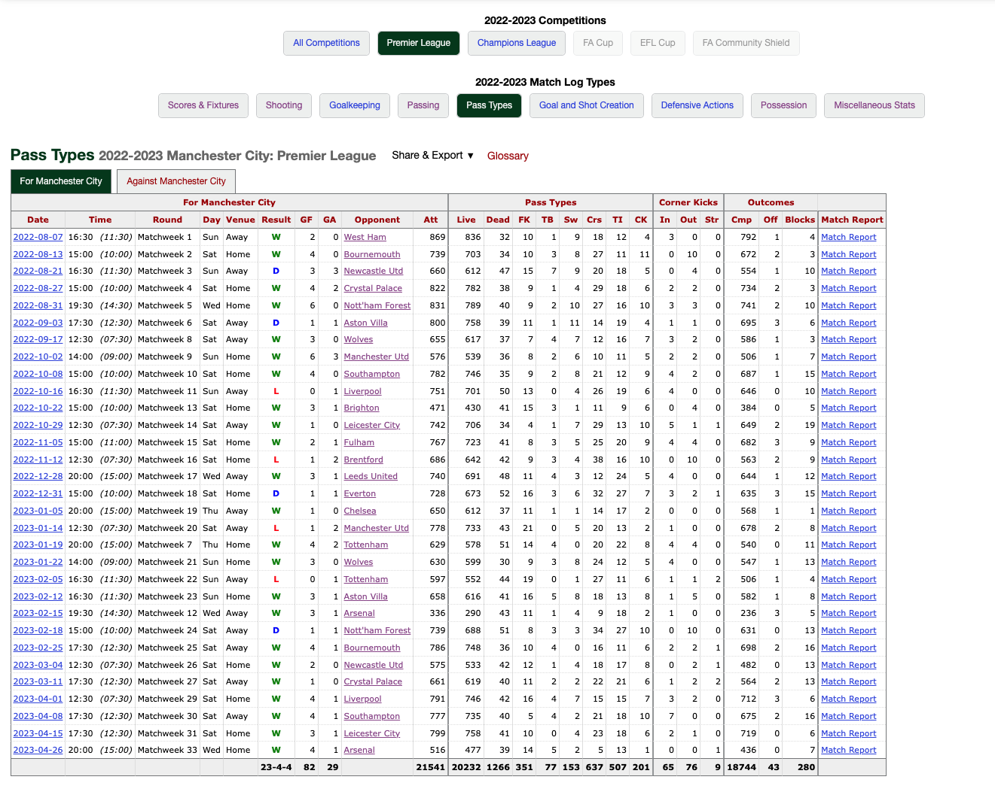
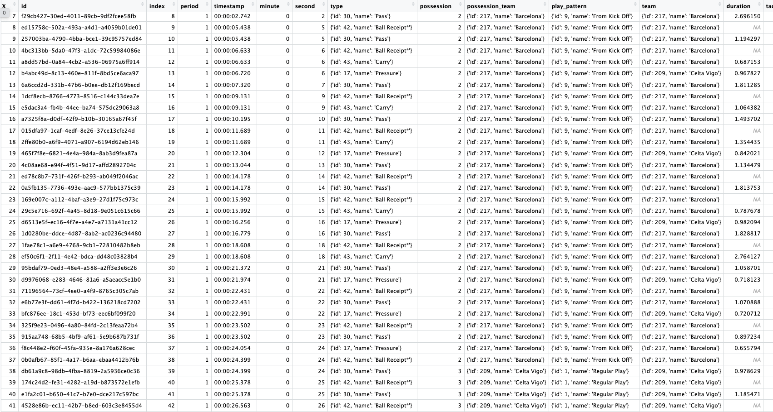
Data
Preferences of teams
How these Preferences are carried out & shared by different players of this team
Is it effective?
Seasonal Stats
Match Stats
Miscellaneous Stats;
Match scores
Pass types;
Number of Crosses
Possession;
Possession Rate
location;
(32.3, 49.8)
Event types;
{'id': 30, 'name': 'Pass’}
timestamp;
00:02:47.915
https://fbref.com/en/squads/b8fd03ef/2022-2023/matchlogs/c9/passing_types/Manchester-City-Match-Logs-Premier-League
https://github.com/statsbomb/open-data

Slide 4
Team in the league - My thoughts
Preferences of teams
How these Preferences are carried out & shared by different players of this team
Is it effective?
Domain
Statistics
Select variables that could represent the intention/desire of team for attacking.
Use of classification to filter teams with strong intention/desire of attacking.
Progressive Carry / - (Possession)
Progressive Pass / n pass - (Passing)
Possession rate - (Possession)
passes to attacking area / n pass ratio (Passing)
carries to 1/3 / carries - (Possession)
PPA - (Passing)
n-cross - (Pass Type)
TB - (Pass Type)
Take-On (Possession)
k-means clustering
PCA

Slide 5
Statistical Results
Preferences of teams
How these Preferences are carried out & shared by different players of this team
Is it effective?

Slide 6
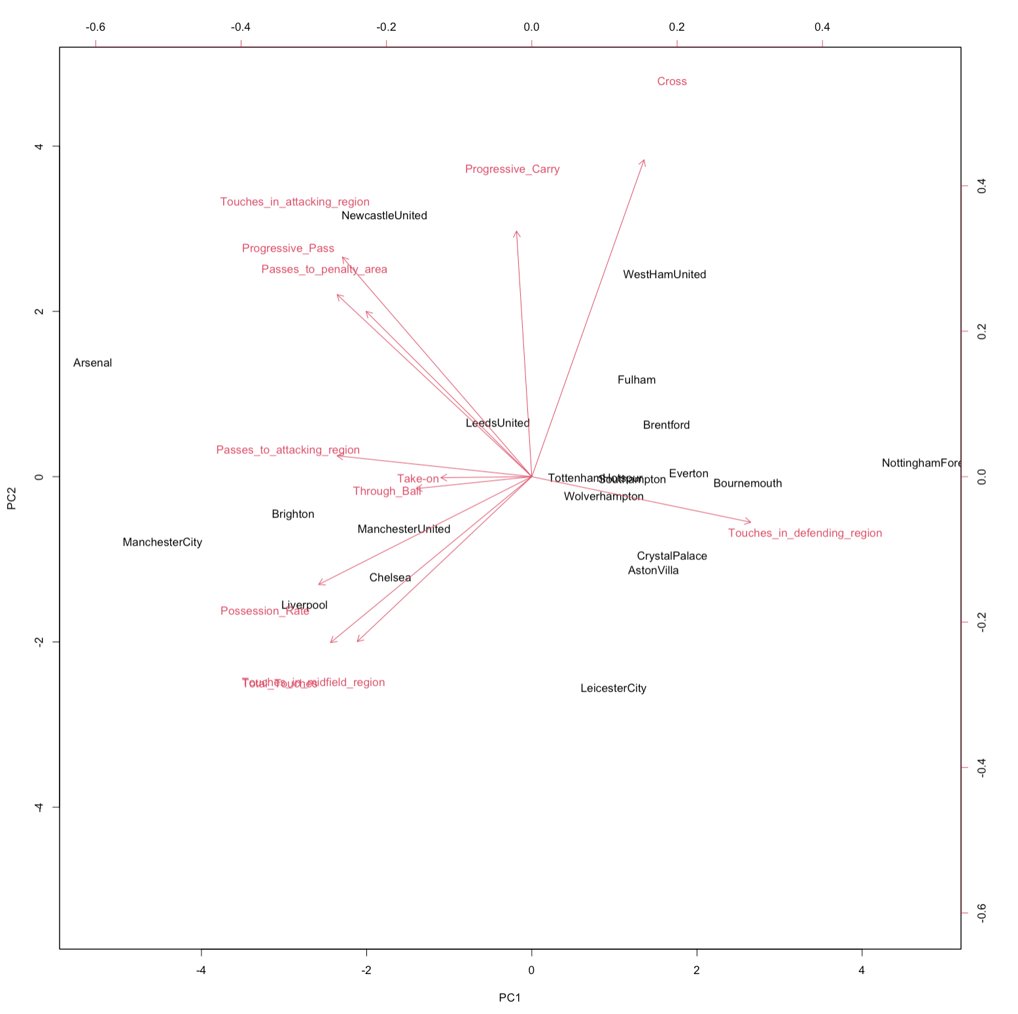
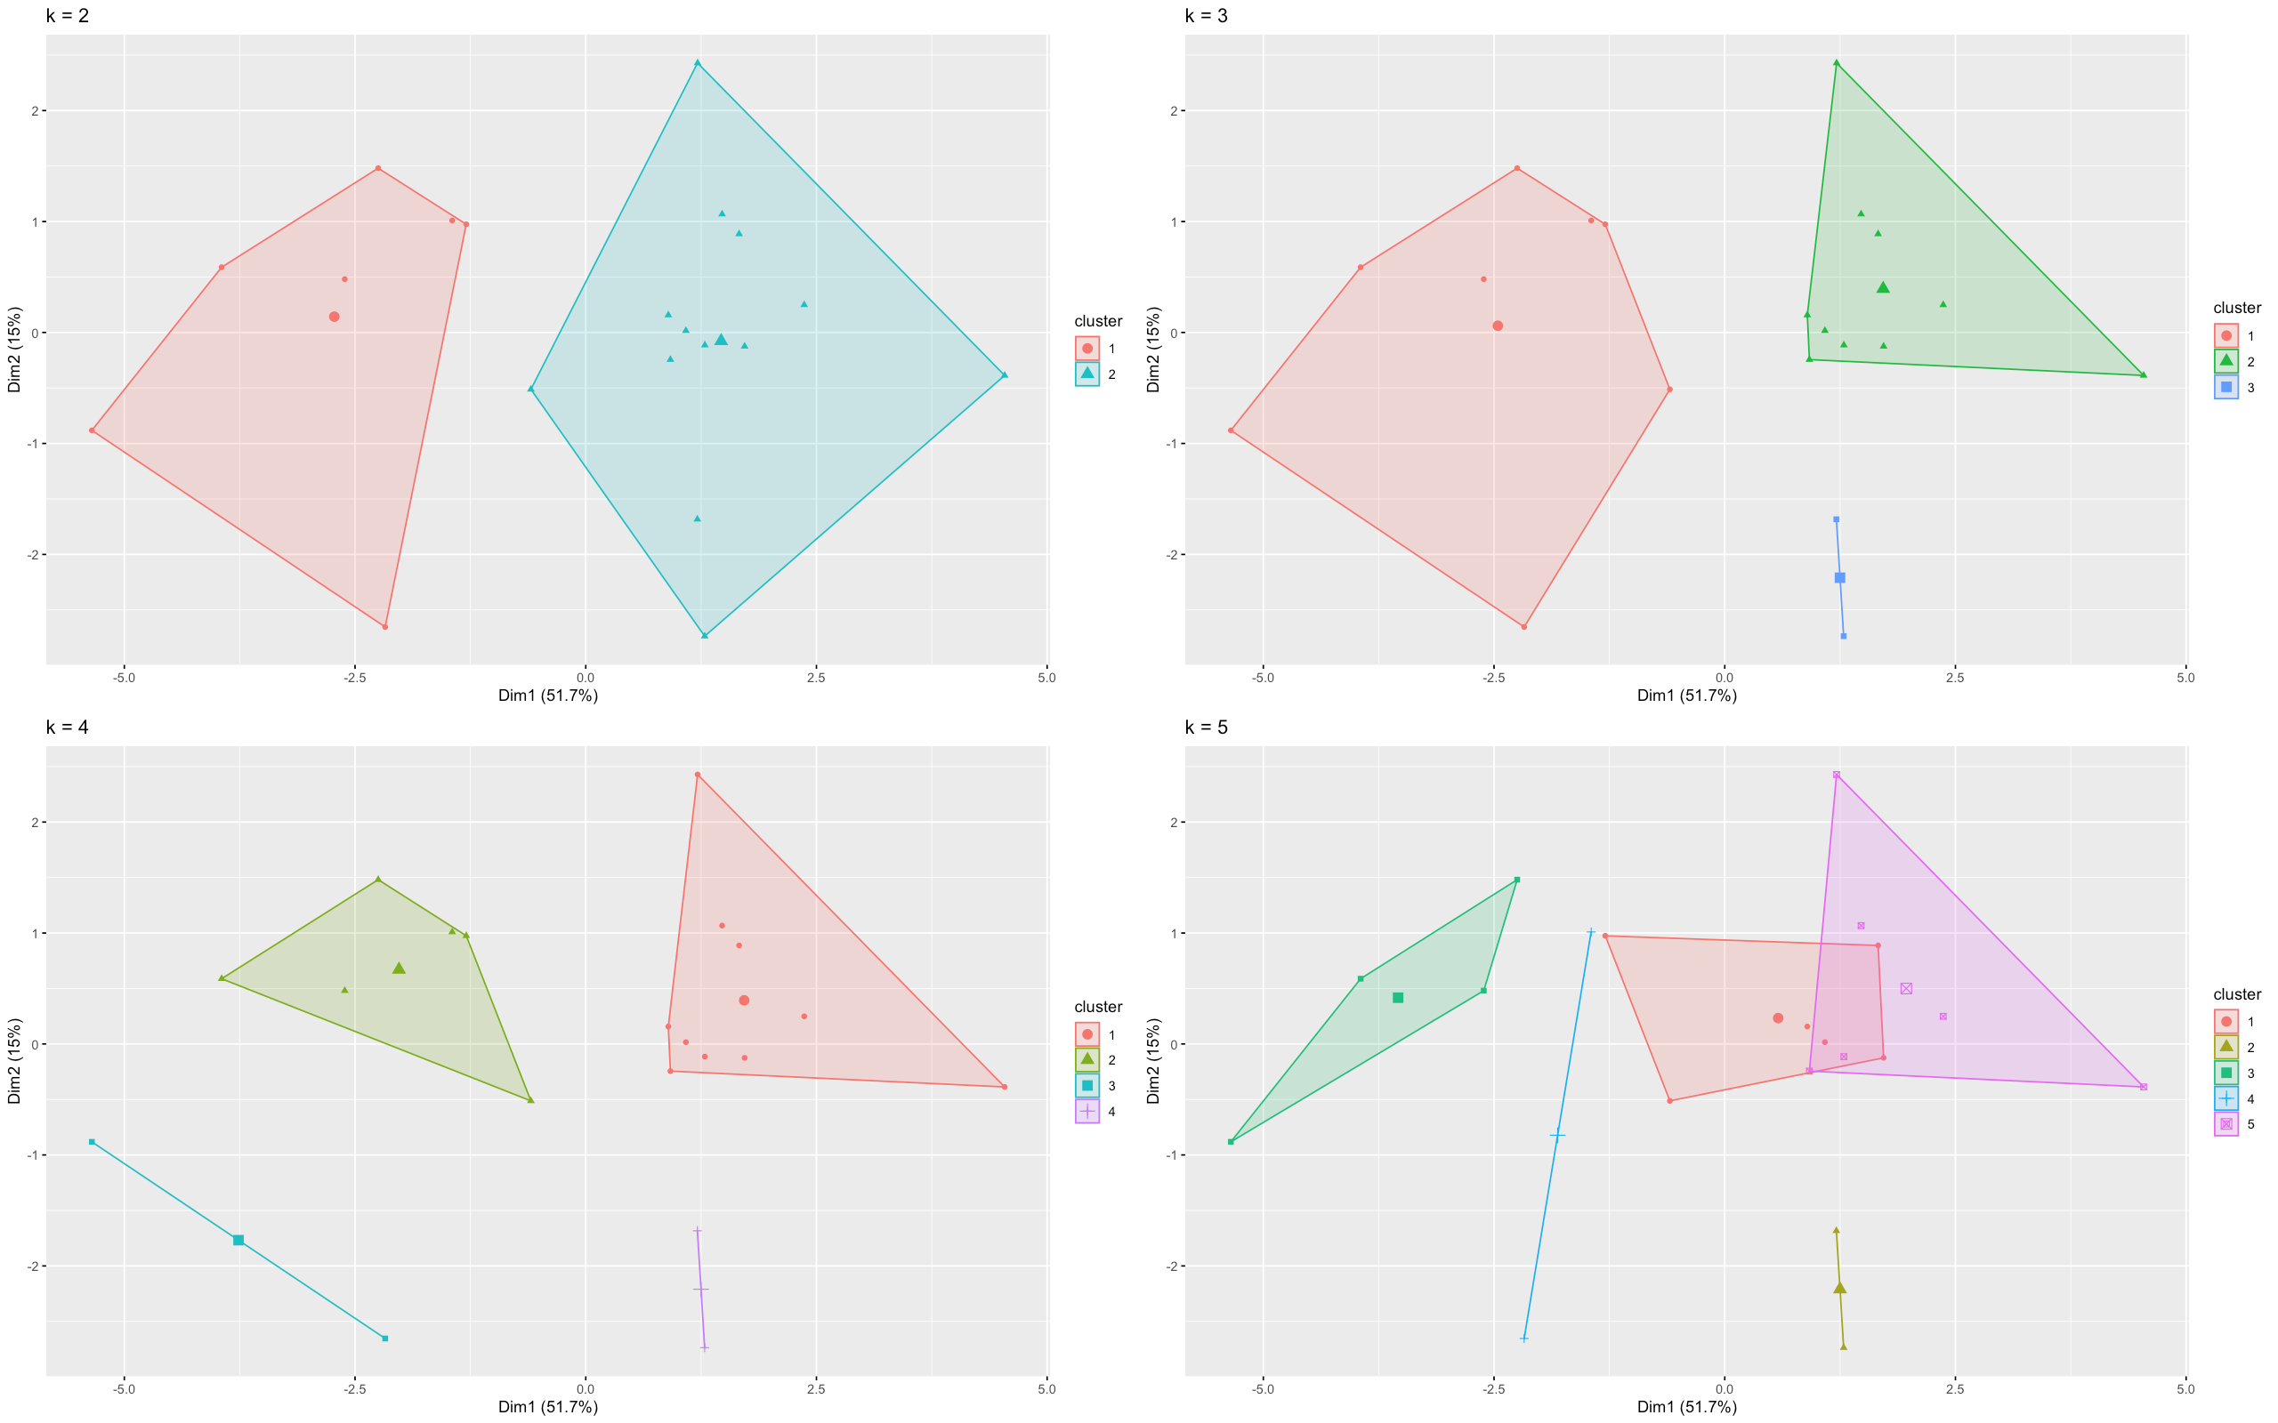
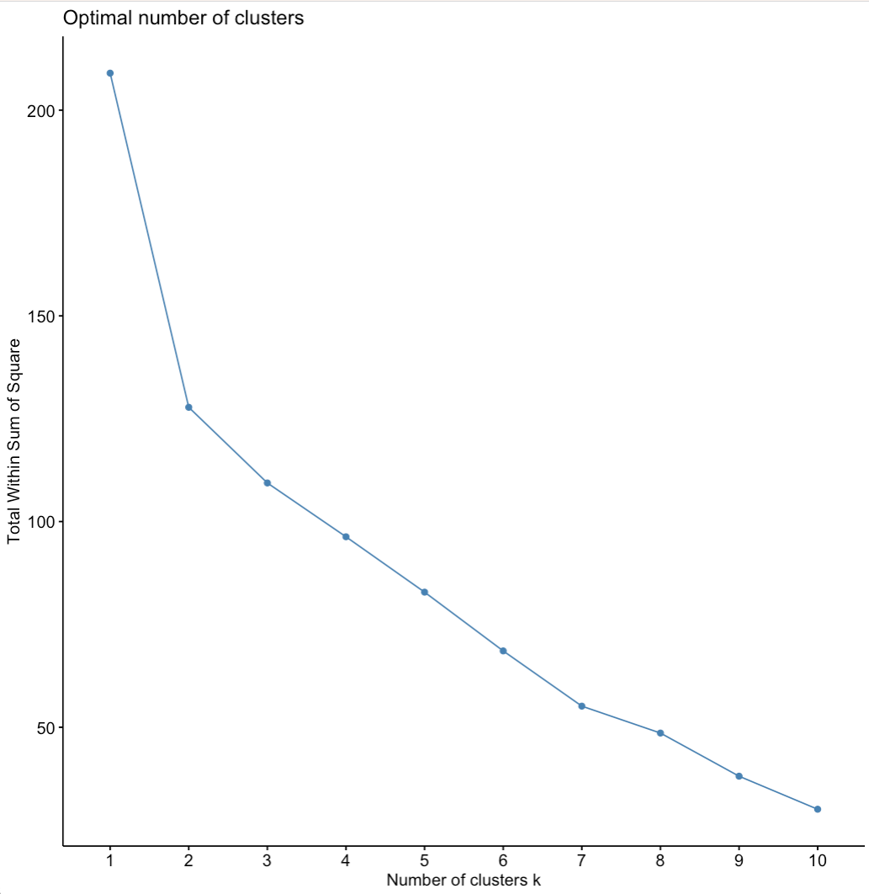
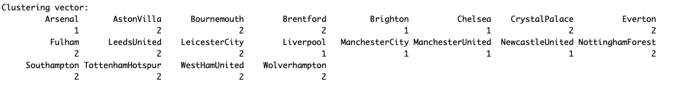
Preferences of teams
How these Preferences are carried out & shared by different players of this team
Is it effective?

Slide 7
Domain-related Results
Preferences of teams
How these Preferences are carried out & shared by different players of this team
Is it effective?

Slide 8
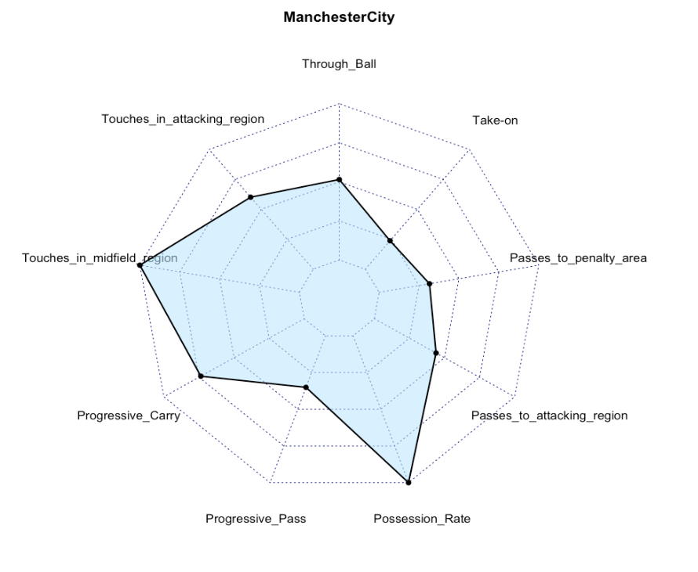
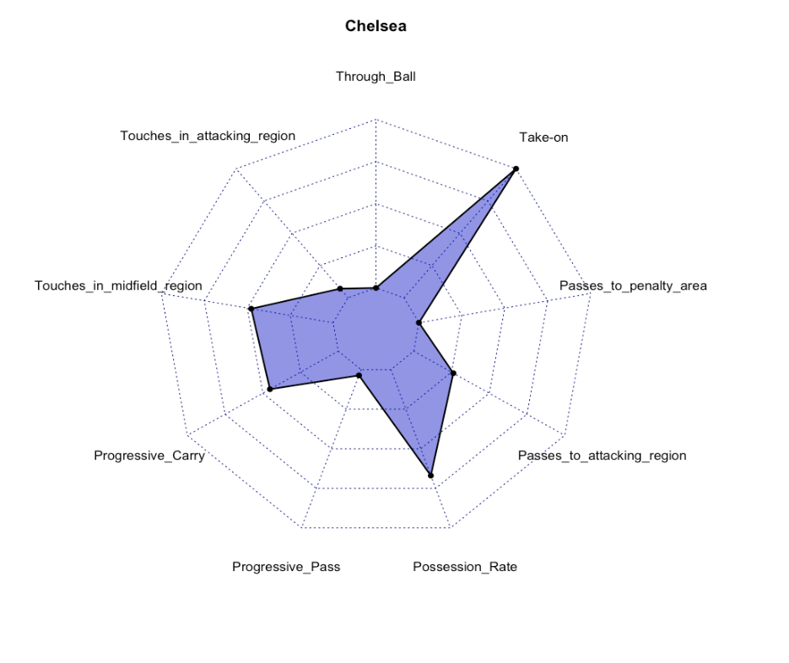
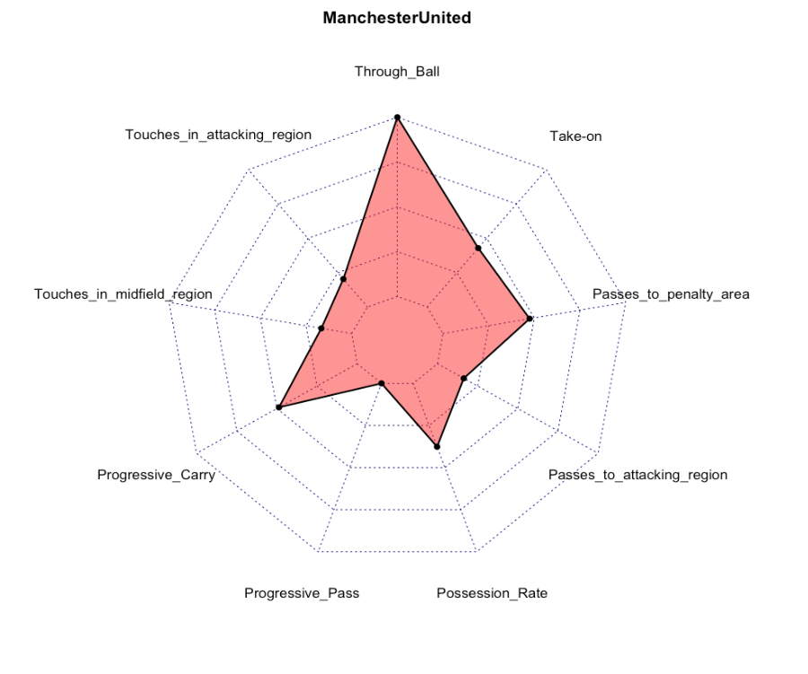
Preferences of teams
How these Preferences are carried out & shared by different players of this team
Is it effective?

Slide 9
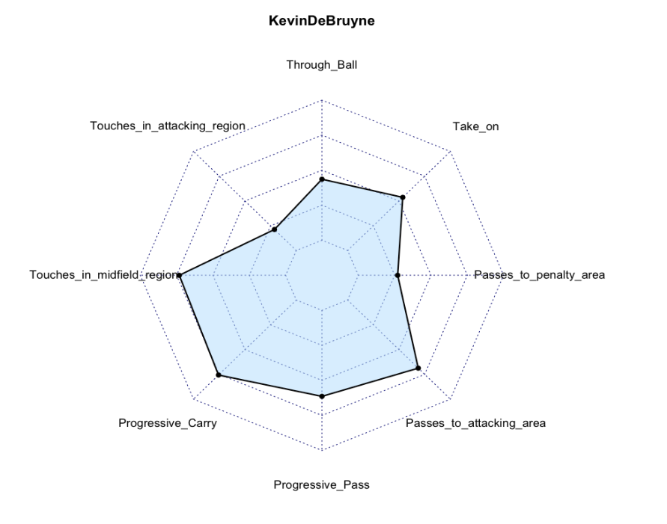
Preferences of teams
How these Preferences are carried out & shared by different players of this team
Is it effective?

Slide 10
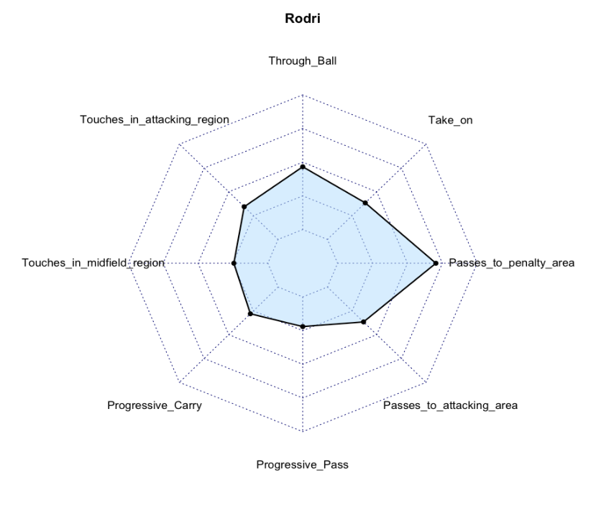
Preferences of teams
How these Preferences are carried out & shared by different players of this team
Is it effective?

Slide 11
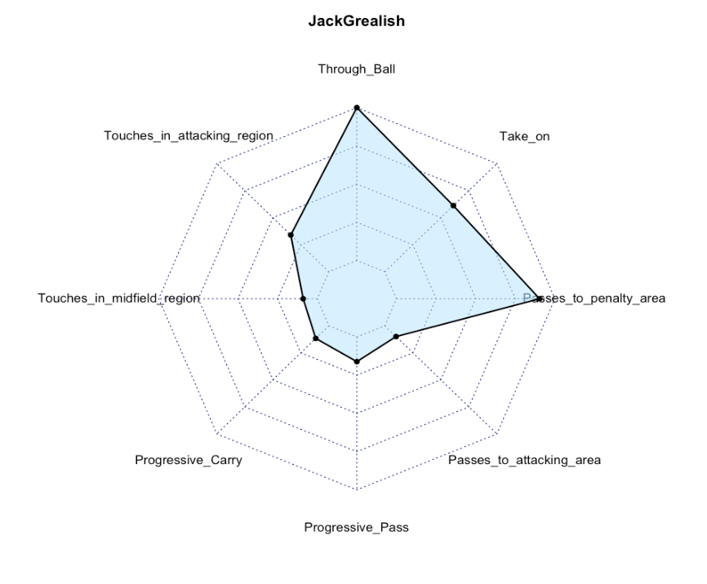
Preferences of teams
How these Preferences are carried out & shared by different players of this team
Is it effective?

Slide 12
Is it Effective?
Preferences of teams
How these Preferences are carried out & shared by different players of this team
Is it effective?
Event-specific focused analysis

Slide 13
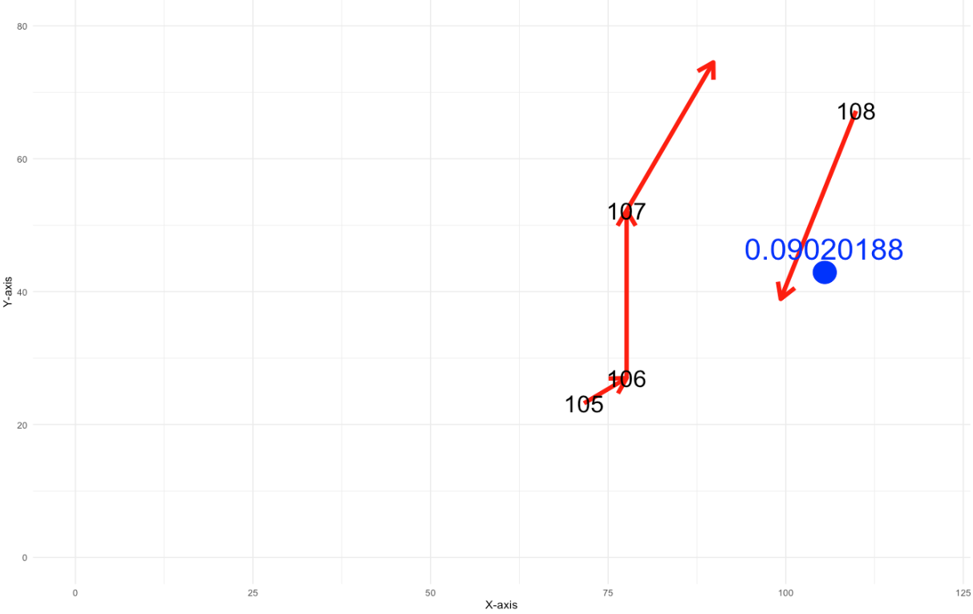
Preferences of teams
How these Preferences are carried out & shared by different players of this team
Is it effective?
Effectiveness
What kind of passes are contributing to a scoring opportunity
How many times such passes are made
Effectiveness of team tacticts
Opponent
Goal

Slide 14
Team in a match – Classification on Passes
Preferences of teams
How these Preferences are carried out & shared by different players of this team
Is it effective?
Domain
Statistics
Identify the Features and pick weights for each trait, help with classification.
Use of Machine Learning on these weights to identify the desired specific event.
Example:
Cross: In soccer, a “cross” is a medium- to long-range pass intended to create goal-scoring opportunities.
With the initial weights, use machine learning to adjust the weights to reach the best way to identify a pass.
<ini_x > 70 & end_y > 18 & end_y < 62 & end_x > 95 & diff_y > 10 & (ini_y < 18 | ini_y > 62)>
y: 0 → 80
diff_y greater → more weight
(ini_y<18 | ini_y>62) → more weight
x: 0 → 120

Slide 15
Thanks
Questions

